Slide 1
Chapter 11

Slide 2
Objectives

Slide 3
Objectives (continued)

Slide 4
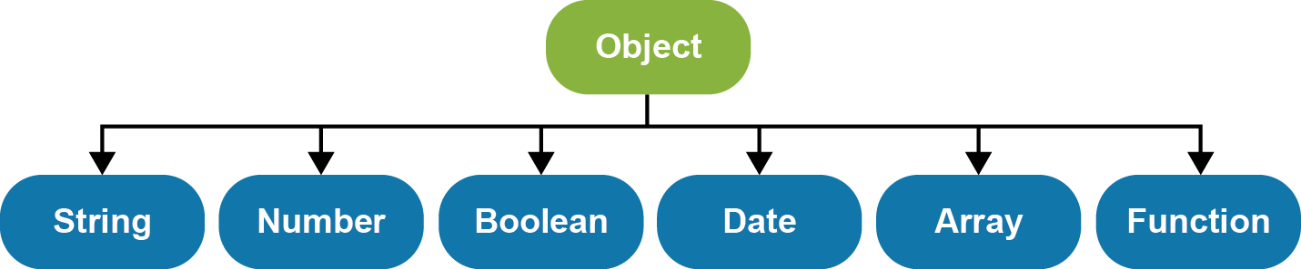
The JavaScript hierarchy of some of the native object types

Slide 5
The syntax for creating a new object of a native type

Slide 6
How to create a new object of a native type with literal values

Slide 7
How to use the properties and methods of the native object types

Slide 8
How to initialize a new object with properties and methods

Slide 9
How to initialize a new object with properties and methods (continued)

Slide 10
How to nest objects and refer to the nested properties and methods

Slide 11
How to add properties and methods to an object

Slide 12
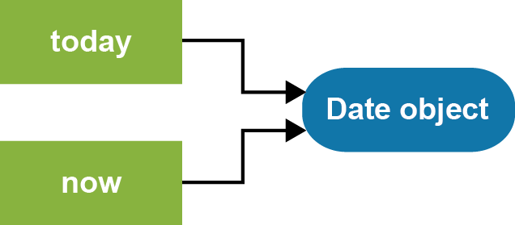
Two variables that refer to the same object

Slide 13
How to delete an object

Slide 14
How to code constructors that create instances of object types

Slide 15
How to add a method to an object type

Slide 16
How to create and use object types

Slide 17
Terms

Slide 18
Some of the methods of a new object’s prototype object

Slide 19
Examples of calling and overriding the methods of an object’s prototype

Slide 20
Examples of calling and overriding the methods of an object’s prototype (continued)

Slide 21
Terms

Slide 22
The arrays used in the examples that follow

Slide 23
Code that creates a new object for every invoice in the array

Slide 24
Code that uses a constructor for every invoice in the array

Slide 25
The create method of the Object object

Slide 26
A custom prototype object with one method

Slide 27
A factory function that creates a custom prototype object

Slide 28
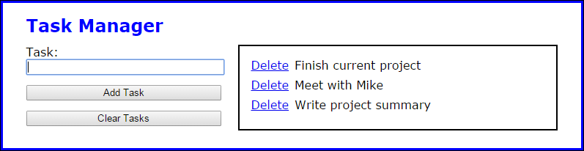
The Task Manager application

Slide 29
The HTML for the Task Manager

Slide 30
The library_storage.js file

Slide 31
The library_task.js file

Slide 32
The library_tasklist.js file

Slide 33
The library_tasklist.js file (continued)

Slide 34
The library_tasklist.js file (continued)

Slide 35
The main JavaScript for the Task Manager app

Slide 36
The main JavaScript (continued)

Slide 37
A percentPrototype object

Slide 38
Some objects that use the prototypes

Slide 39
How to override a prototype’s method while still using its functionality

Slide 40
A constructor function that creates a Percent object

Slide 41
A constructor for a Commission object that inherits the Percent object

Slide 42
Some objects that use the constructor objects

Slide 43
How to override a prototype’s method while still using its functionality

Slide 44
How to add a method to the String object type

Slide 45
How to add a method to the Date object type

Slide 46
How to add a method to the Math object

Slide 47
How to check if the method exists before adding it

Slide 48
A method that modifies an object but doesn’t return the object

Slide 49
A method that modifies an object and then returns the object

Slide 50
Chaining method calls on a custom object

Slide 51
The objects and variables used by the operators that follow

Slide 52
How to use the in operator

Slide 53
How to use the instanceof operator

Slide 54
How to use the typeof operator

Slide 55
The library_native_objects.js file

Slide 56
The enhanced library_storage.js file

Slide 57
The enhanced library_storage.js file (continued)

Slide 58
The enhanced library_tasklist.js file

Slide 59
The enhanced library_tasklist.js file (continued)

Slide 60
The enhanced main JavaScript for the Task Manager application

Slide 61
The main JavaScript (continued)

Slide 62
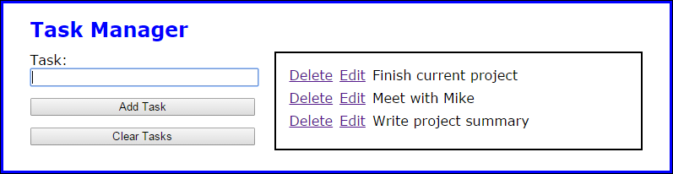
Exercise 11-1 Enhance the Task Manager app

Slide 63
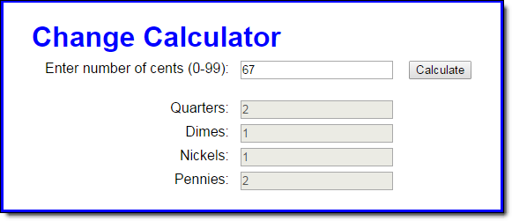
Extra: Use objects with the Change Calculator

Slide 64
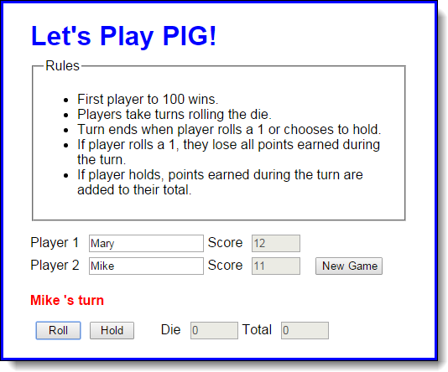
Extra 11-4 Convert the PIG app to objects

Slide 65
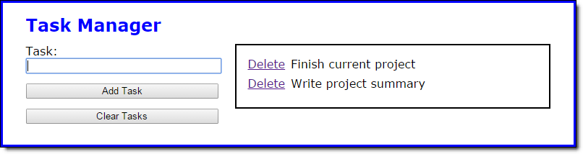
Short 11-1 Add a method to the String object

